Slide 1
GW Academy Meeting 04/05/22: Market Research
¹Arise, shine; for thy light is come, and the glory of the LORD is risen upon thee.
² For, behold, the darkness shall cover the earth, and gross darkness the people:
but the LORD shall arise upon thee, and his glory shall be seen upon thee.
Isaiah 60:1-2

Slide 2
Agenda : Market Research
Prayer & Scripture & Word Nugget
Welcome & Opening
Word Nugget
Review & Discussion of Problem/Solution Assignment
Assignment Discussion
Market Research
Market Research
Questions Your Market Research Should Answer
Needed Data
Assignment

Slide 3
Word Nugget: Spirit of Lethargy
Go to the ant, thou sluggard;
consider her ways, and be wise:
⁷ Which having no guide, overseer, or ruler,
⁸ Provideth her meat in the summer,
and gathereth her food in the harvest.
⁹ How long wilt thou sleep, O sluggard?
when wilt thou arise out of thy sleep?
¹⁰ Yet a little sleep, a little slumber,
a little folding of the hands to sleep:
¹¹ So shall thy poverty come as one that travelleth,
and thy want as an armed man. Proverbs 6:6-11
God says we need to face our enemies within. When we recognize they are enemies, God Himself will fight the war for us.
Satan is desperate to stop us from doing these businesses. He will cause our flesh to feel weary and make it feel legitimate.
We must stop making excuses and kick him out so that poverty and want don’t sneak up on us.

Slide 4
Final Review & Discussion of Problem Solution Assignment

Slide 5
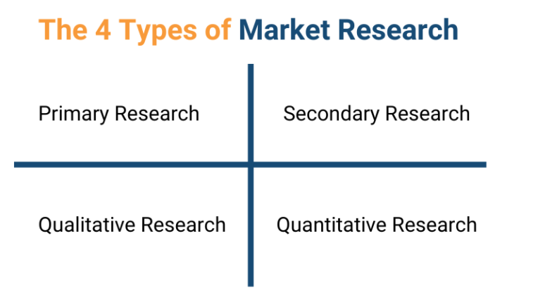
Market Research
  What Is Market Research?
Market research is an organized effort to gather information about target markets and customers: know about them, starting with who they are. It is an important component of business strategy and a major factor in maintaining competitiveness.

Slide 6
Primary Research
Primary research refers to first-party data or information. First-party data or information is all the data and information you’ve collected on your own—you’re not citing any other source’s work. Examples of primary market research include:
  Focus groups
  Interviews
  Polls
  Surveys
This type of market research can help strengthen your marketing strategy with data and information that comes directly from your potential customers.
Good examples of primary research are online surveys and polls, which are a great way to get a large number of responses from your customer base.

Slide 7
Secondary Research
Secondary research refers to second-party or third-party data or information. Second- and third-party data is collected from what already exists within the market. The research is not done by you, but by other businesses or organizations. Examples of secondary market research include:
Articles
eBooks
Infographics
Videos
White papers
This type of market research can help you get a better understanding of your industry as a whole. You’ll be able to identify how competitors operate, important industry statistics, and other valuable insights that you can use to help create a more informed marketing strategy overall.
Secondary research is the best way to get a feel for the data and information that already exists within your industry and among your competitors.

Slide 8
Qualitative Research
Qualitative research refers to the collection of data that can’t be measured.
Qualitative research can be primary or secondary. You can use primary market research methods such as interviews, polls, and surveys to find out how customers feel about your product or service. The goal is to understand how they think. You can ask open-ended questions like:
A great way to utilize qualitative research is to do it during a product launch. The goal is to get as much customer feedback about your new product as possible.
Qualitative research can help you gauge whether it has met customer expectations or falls short. If it does fall short, dig deeper and find out in what areas it doesn’t meet customer expectations. Is it a quality issue? Price point? Competitors offering better products? Qualitative research gives you that critical insight into how customers feel about your product or service.

Slide 9
Quantitative Research
Quantitative research refers to collecting numbers for statistical analysis. Like qualitative research, quantitative research can be primary or secondary in nature.
This type of market research is all about having the figures to back up your marketing strategy. The stats aren’t interpretations—they’re empirical evidence. Quantitative primary market research can look like:
Quantitative primary market research can look like:
  Dr. Google is one of the best, and cheapest sources of data and, and added advantage is that its FREE! The key with Google is asking the right questions.
  However, there are other sources available online that can be very helpful as well. The GW website has an entire list of these data sources here: https://gloryworks.info/market-research/
Alexa Rank | Social media followers
Bounce rate | Social media engagement
Pageviews | Subscribers

Slide 10
Questions Your Research Should Answer
Who will buy our products and services? | Who are our competitors?
What will motivate, influence and incentivize these people to choose us? | What are our competitors doing to acquire customers?
How will these people buy from us? (e.g. direct, online, channel partners, affiliates, etc. | How are our competitors perceived by our target market?
Are we charging the right price, and what would the sale impact be by lowering/raising the price? | How can we effectively reach all of the people who would buy from us?/
What is happening in the external environment that is decreasing demand for our offering? | What is happening in the external environment that is increasing demand for our offering?

Slide 11

General Discussion

Slide 12
Assignment 3: Complete the Market Research Section of Your Business Plan
Complete your research.
Go to the Business Plan Template.
Pass over the Executive Summary. Ignore it for now. Leave it blank. We will do it last.
Go to the section of the plan entitled “Target Market”
Write out your description of your target market and email it to Minister Dona.
This section should include:
A detailed description of the type of person who would buy your product and why they would buy it
How many of them are there?
How much money do they have?
How can you reach them?
Why will your product/service interest them?
Will the number of people who want your product grow or shrink in the future? Why?

Slide 13
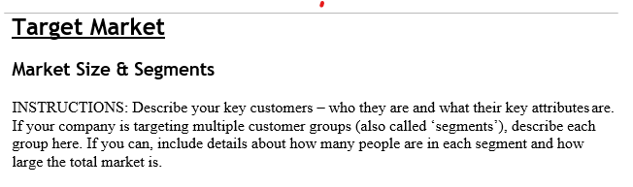
What This Section of Your Business Plan Template Looks Like:

Slide 14
Questions
?

