Slide 1
GW Academy Meeting 3/22/22: The Why of Your Business
¹Arise, shine; for thy light is come, and the glory of the LORD is risen upon thee.
² For, behold, the darkness shall cover the earth, and gross darkness the people:
but the LORD shall arise upon thee, and his glory shall be seen upon thee.
Isaiah 60:1-2

Slide 2
Agenda : Market Research
Prayer & Scripture & Word Nugget
Welcome & Opening
You are the Light of the World
Word Nugget
Review & Discussion of Mission Statements
Assignment Discussion
Does Your Business Solve a Problem?
Problem
How Do You Solve It?
Solution
Breakout Sessions

Slide 3
Word Nugget: Light of the World
14 Ye are the light of the world. A city that is set on an hill cannot be hid. 15 Neither do men light a candle, and put it under a bushel, but on a candlestick; and it giveth light unto all that are in the house. 16 Let your light so shine before men, that they may see your good works, and glorify your Father which is in heaven. Matthew 5:14-16
We are the containers of God’s Glory and everywhere we go, we should light things up. We are literally lights!
Your responsibility in the marketplace is to allow (LET) your light shine that when men see the way you do business, the excellence of God and the wisdom of God in your business, the Father is glorified.
You cannot allow yourself to be talked out of your light or to be discouraged by darkness around you.
You are there to dispel the darkness!

Slide 4
Mission Statement Review
  What Is a Mission Statement?
A mission statement is used by a company to explain, in simple and concise terms, its purpose(s) for being.
It is usually one sentence or a short paragraph, explaining a company's culture, values, and ethics.
Mission statements serve several purposes, including motivating employees and reassuring investors of the company's future.
  Volunteers?

Slide 5
Does Your Business Solve a Problem??
Solve real painful problems. Google made search better. Amazon simplified online buying and selling. Netflix solved on-demand streaming media. Uber is trying to make on-demand car service better. What can you make smarter or better?
Your business should be your passion. Let the seed that God put in your heart bloom. Dream with God.
"The happiest and most successful people I know don’t just love what they do, they’re obsessed with solving an important problem, something that matters to them," Dropbox co-founder Drew Houston

Slide 6
Does Your Business Solve a Problem??
Coupled with passion, is the ability to execute. If you can't deliver, you are not in business. Products with a real need are easy to market and you won't have to convince people about the existence of the problem and the need for your product because they identify with it.
Do your homework, validate your idea and make sure you have a real market for your idea.
Don't just start another business, solve a real problem people actually have to increase your chances of success.
God will do the rest!

Slide 7
Exercise -
What Problem Does Your Business Solve?
  Once You’ve Determined Your Business Solves a Problem, You Have to Be Able to Do Three Things:
  Be able to articulate the problem your business solves
  Recognize who has the problem
  Recognize the problem when you see it.

Slide 8
Solution – How Do You Solve It?
  What Kind of Things Do You Do Better Than Anybody that Solve This Problem?
  Can You Explain Why You Do Them Better Than Anybody?

Slide 9
How Will You Make Money?
  Will People Pay For You To Do These Things?
  Can you sell your product or service at a price that is affordable to people who need it?
  Can you make it at a price that makes sense?
  If not, where can you get it from?

Slide 10

General Discussion

Slide 11
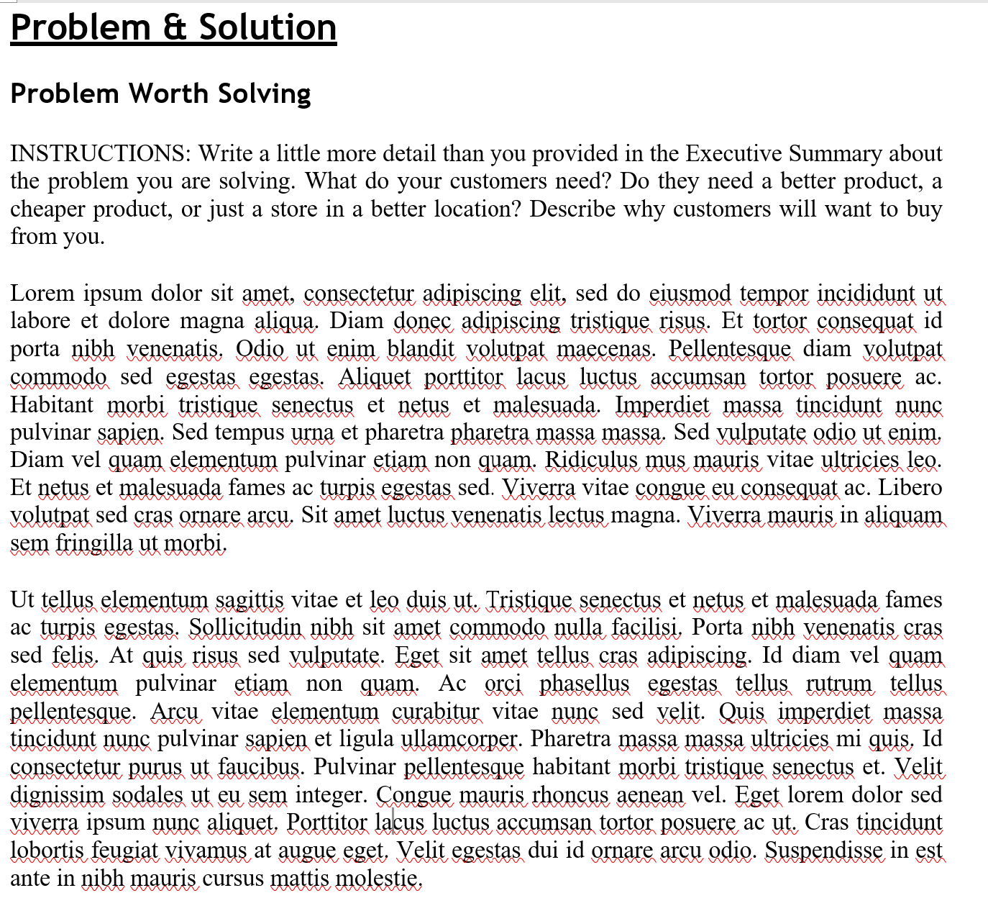
The Business Plan: Write Out the Problem You Are Solving

Slide 12
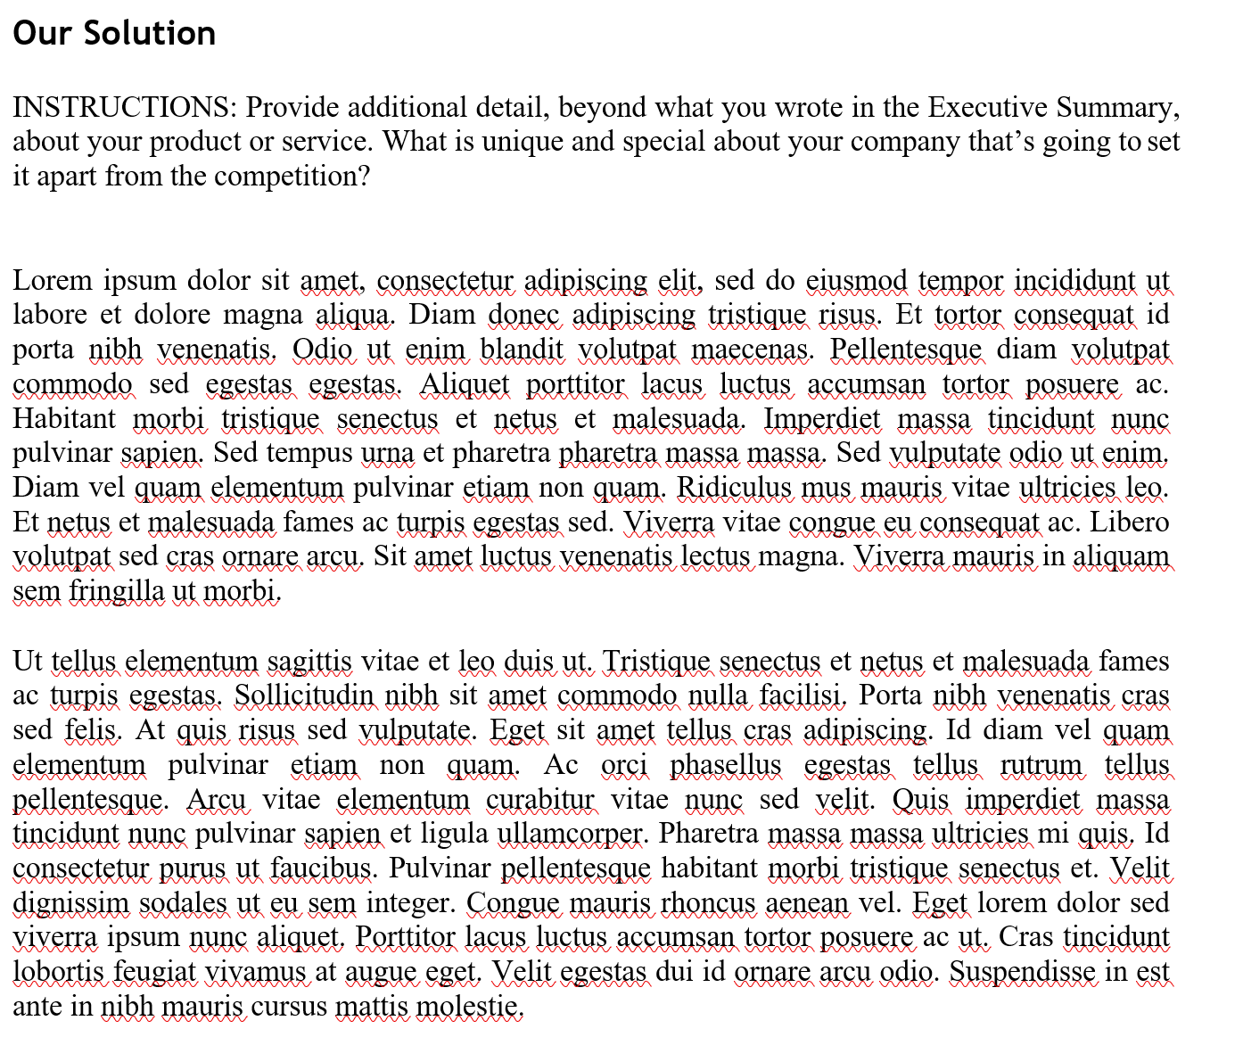
Write Out the Solution – What Makes You Different?
  Growth (Contd)
  Human Resources
  Growth Plans
  Contingency Plans
  Processes
  Training

Slide 13

Questions? Comments?
Your Prayers, Input, Ideas, Help, Labor Are Much Needed & Appreciated!

Slide 14
Break Out Sessions

